Slide 1



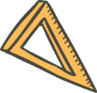



Running with Tiny bit
Route plan
Yahboom

Slide 2









Contents
Preparation
Learning goal
Search for blocks
Combine blocks
Experimental phenomena
Yahboom

Slide 3

Preparation
The position of the motor on the robot car
Programming method:
Mode 1 online programming: First, we need to connect the micro:bit to the computer by USB cable. The computer will pop up a USB flash drive and click on the URL in the USB flash drive: http://microbit.org/ to enter the programming interface. Add the Yahboom package: https://github.com/YahboomTechnology/Tiny-bitLib to program.
Mode 2 offline programming: We need to open the offline programming software. After the installation is complete, enter the programming interface, click【New Project】, add Yahboom package: https://github.com/YahboomTechnology/Tiny-bitLib, you can program.
Yahboom

Slide 4
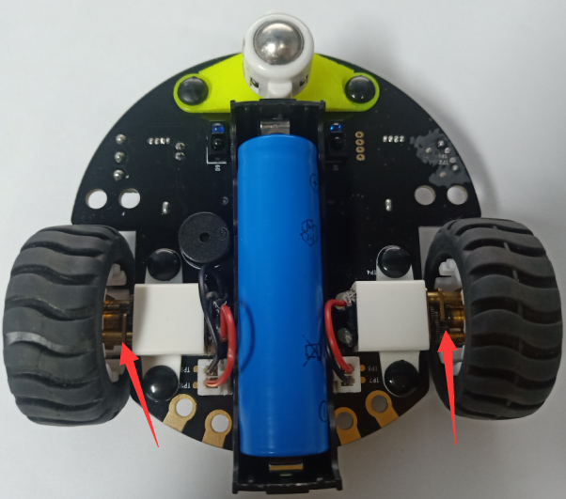
Preparation
The position of the motor on the robot car
Yahboom

Slide 5
Learning goal
1.Learn how to use control motor graphically program building blocks
2.In this lesson, we need to realize button switches four prepared routes and displays the shape of the path on the micro:bit dot matrix.
Yahboom

Slide 6

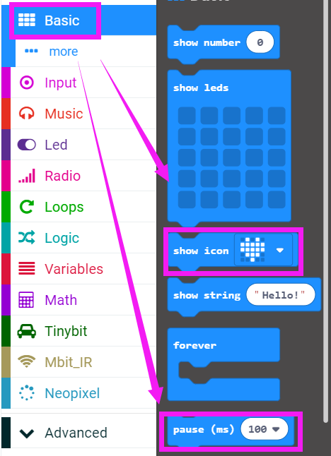
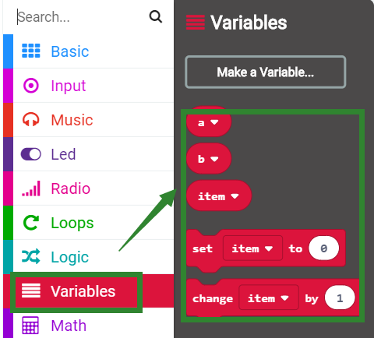
Search for block
The following is the location of the building blocks required for this programming.
Yahboom

Slide 7
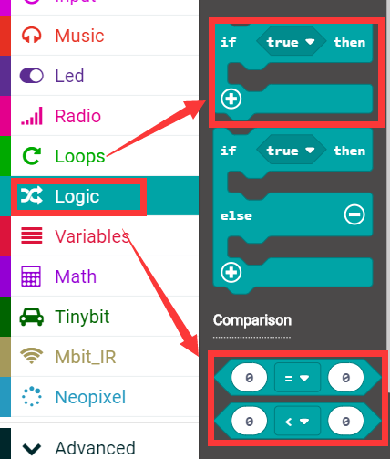
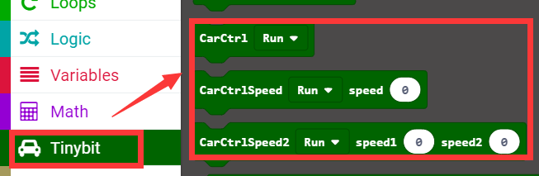
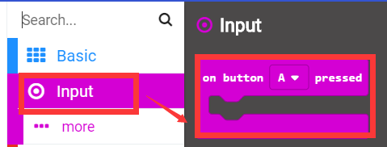
Search for block
Yahboom

Slide 8
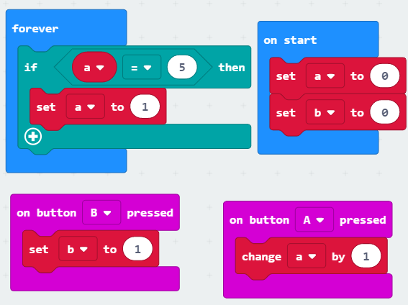
Combine block
The summary program is shown below:
Yahboom

Slide 9
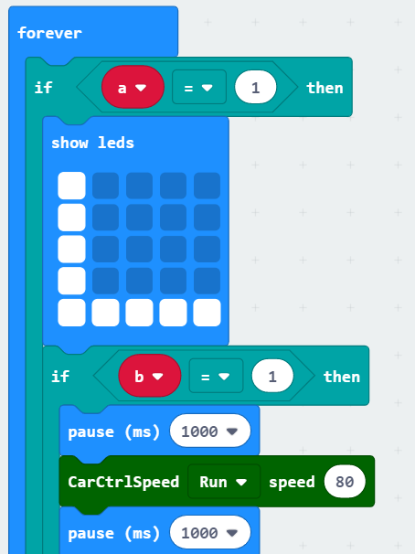
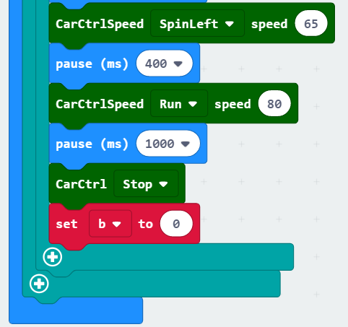
Combine block
Yahboom

Slide 10
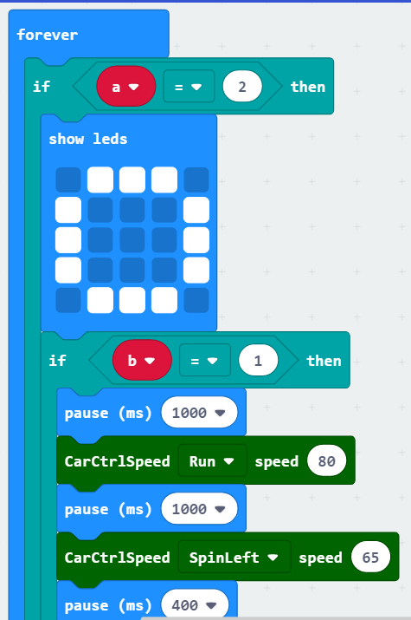
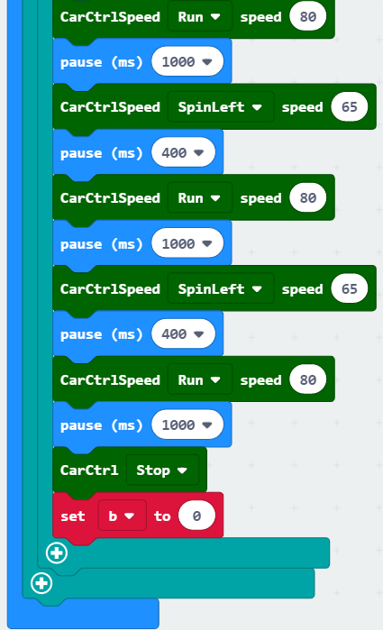
Combine block
Yahboom

Slide 11
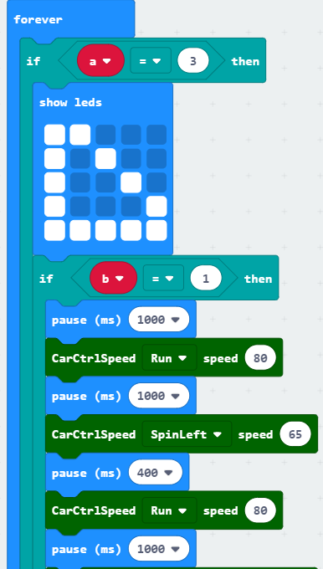
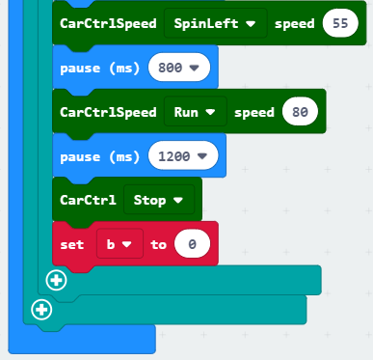
Combine block
Yahboom

Slide 12
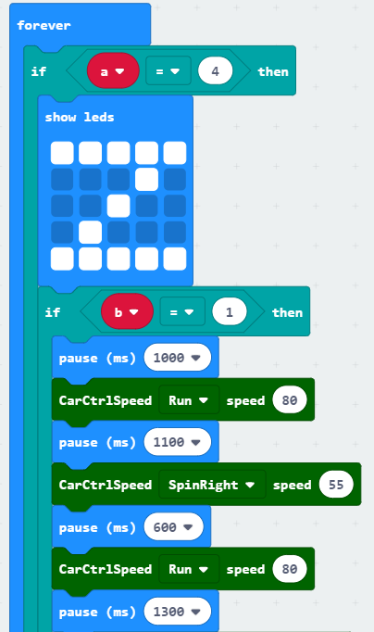
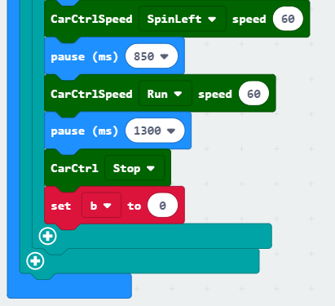
Combine block
Yahboom

Slide 13
Experimental phenomena
After the program download is complete, turn on the power of the car.
When we press the A button for the first time, the dot will display “L”, then press the B button, we can see that the path forwarded by the car is “L”.
When we press the A button for the second time, the dot will show “口”, then press the B button, we can see that the path forwarded by the car is “口”.
When we third press the A button for the third time, “ ” will be displayed on the dot matrix, then press the B button, we can see that the path forwarded by the car is “ ”.
When we press the fourth A button for the fourth time, “Z” will be displayed on the dot matrix, then press the B button, we can see that the path forwarded by the car is “Z”.
When we press the A button for the fifth time, the dot will display “L”, then press the B button, we can see that the path forwarded by the car is “L”.
........
And keep the loop in this state~
Yahboom

Slide 14
Inspire Creativity Embrace Innovation
Thank you!!!

